Slide 1
Page Removal Simulator
Matt Hunt
huntm2@go.Stockton.edu

Slide 2
Introduction
The Page Removal Simulator program was made to simulate the action of page faults and page removal from memory using different page removal schemes
The two page removal methods used in this program are FIFO (First In First Out) and LRU (Least Recently Used)
The program simulates Demand Paging where only parts of jobs are stored in memory and other pages are swapped in only when needed and how they are swapped in are determined by the page removal method
FIFO removes the page that has been in memory the Longest
LRU removes the page that has was least recently used

Slide 3
Installation
To install the Page Removal Simulator program, please select the PageRemovalSimulator.jar and/or the PageRemovalSimulator.exe file(s),
Then either move, or copy and paste them to wherever you wish to store them on your computer
Installation Requirements:
  Note: both the .jar and .exe files contain the same program and do not operate differently, it is only meant as two different options
  In order to use the .jar version, you must have at least Java 8 installed
  In order to use the .exe version, you must be on a windows computer

Slide 4
Features
The Page Removal Simulator program allows the user to simulate different page removal methods (FIFO and LRU) as well as see the results of method with the failure rate
The failure rate is the amount of faults divided by the total number of page requests expressed as a percent
The user sets the amount of total frames available in the memory
User can set 2 to 5 frames of memory
Once the frames are set the user enters in a job that they want to add and then press either the FIFO or the LRU button in order to run one of those methods and add the job accordingly

Slide 5
Important Notes
The program is only designed to handle FIFO and LRU one at a time, meaning that if the user starts with using FIFO, continue using FIFO until you are done
Do not mix pressing both the FIFO and LRU buttons
In order to switch between each please restart the program
In order to use LRU, please click the “Switch to LRU” button after entering the frame number and before entering a job and clicking LRU, this sets counters in the program to coincide with LRU and not FIFO
LRU will not work unless this button is clicked first
Because the way the program is designed, the initial additions to fill the memory are not counted as page faults, only after the memory is fill and pages start getting swapped are page faults recorded
The initial additions are treated as the setup of the program

Slide 6
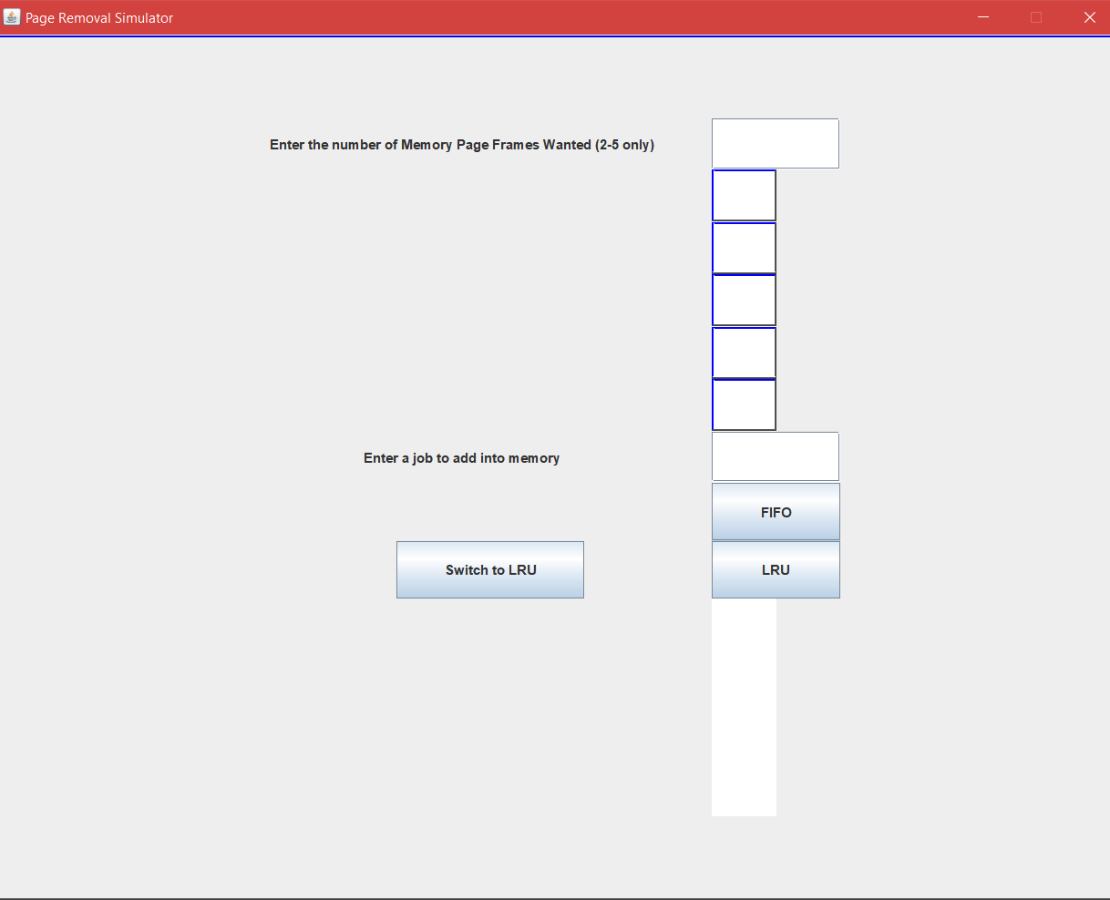
GUI

Slide 7
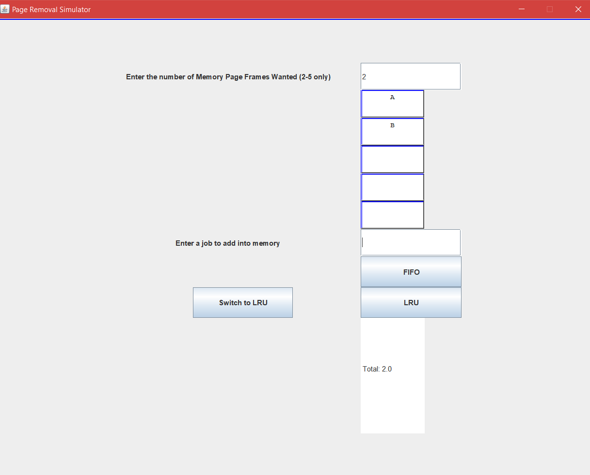
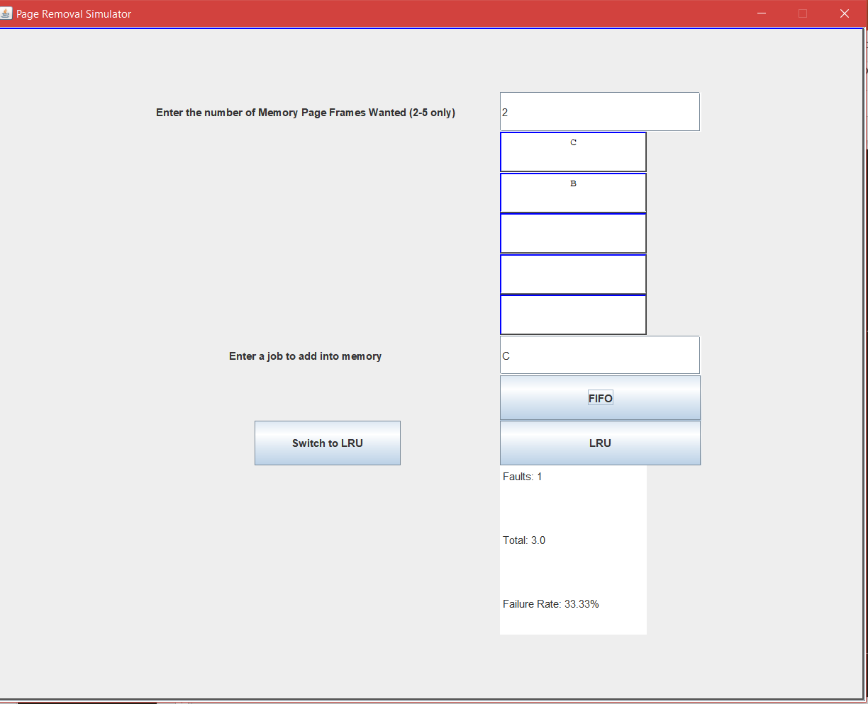
Short Example (FIFO)

Slide 8
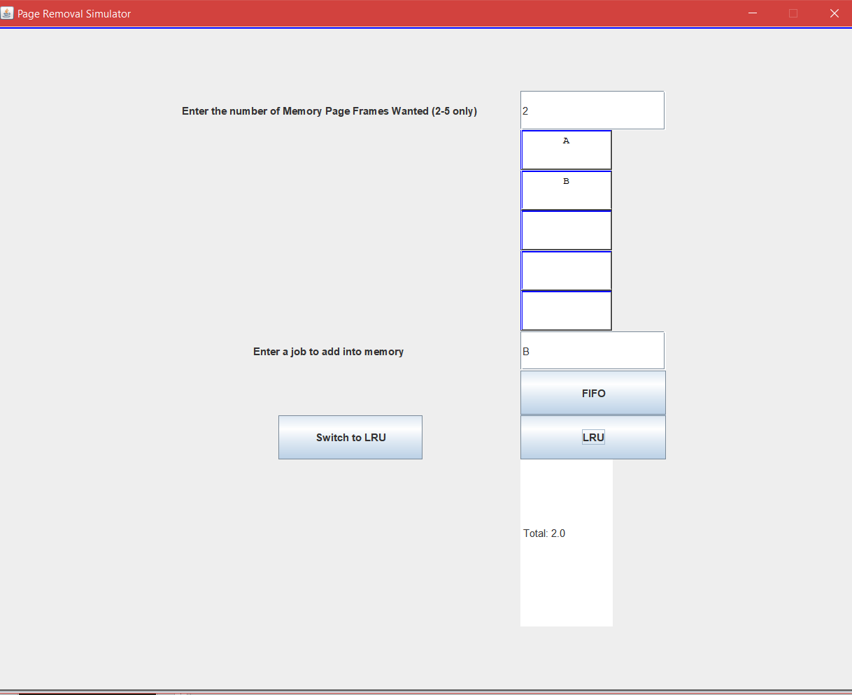

Short Example (LRU)

